Slide 1
Guide Book Pro
Team Savants:
Alex Rodriguez, Ty Mcphail, Adam Axelrod, Arturo Garcia, Brody Hayden

Slide 2
Overview
System Request
Narrative: Problem Statement, Business Case, & Feasability Considerations
Product Features
Process Models: As-Is & To-Be
Conclusion: Limitations & Future Work

Slide 3
System Request
Business Needs:
A system to offer their most sought-after fishing experiences in a more exclusive manner
A platform that caters to the niche audience that prefers paying a premium to expedite highly coveted adventures.
Facilitate an efficient booking process for clients with tight schedules
Business Requirement:
Built in search functions and/or fluid page design.
Filter traffic to only allow permitted visitors
Payments or inquiry form submission should be accepted at the end of the experience on the site.
Automatically contact clients for updates and reminders as trips are finalized.

Slide 4
Business Value
High value, exclusive services, with low risk of cancellation.
Cost-effective, subscription-based model.
Leverages the existing Guide Book network.

Slide 5
Special Issues & Considerations
Travel restrictions regarding international bookings.
PCI regulations could mean extensive technical development.
Must leverage existing infrastructure while still bringing an exclusive & distinguished experience.
Reallocate existing staff/expand workforce.

Slide 6
Problem Statement
Guide Book has found success in giving fishing guides a platform to market their services.
The niche market of high-earning individuals seeking more luxurious offerings remains available to capture.
Guide Book has recruited both clientele and prestigious guides for this type of service.
The final step is to develop the extension of their platform to host this experience.

Slide 7
Feasibility
Technical Feasibility
Building Guide Book Pro on top of the existing service reduces technical risk and simplifies development procedures.
Guide Book Pro will require certain additions, such as content restriction, inquiry forms, and direct lines of communications for customers.
Organizational Feasibility
Guide Book Pro will serve a niche section of a broader market that the company is well-established in.
The new model will provide satisfaction to a new customer-base, while still allowing for the existing service to thrive separately.

Slide 8
Economic Feasibility
Development Cost
Primary initial costs are attributed to reserving guides.
Development costs for Guide Book Pro are unlikely to exceed existing development team cost (~$20,000/month).
Additional plugins vary in price and frequency of payment (one-time/annual).
Annual Benefits
Estimated Year 1 subscription earnings: $40,000 (~20 subscribers @ $2,000)
Assuming a 2x increase in subscribers yearly, this increases to $640,000 at Year 5.
An established subscription model brings opportunities for additional sources of revenue in the future, such as through optional amenities.

Slide 9
Product Features
Efficient booking process
Advanced Search and filter functionality
Survey form prompt
Client invitation
Payment acceptance

Slide 10
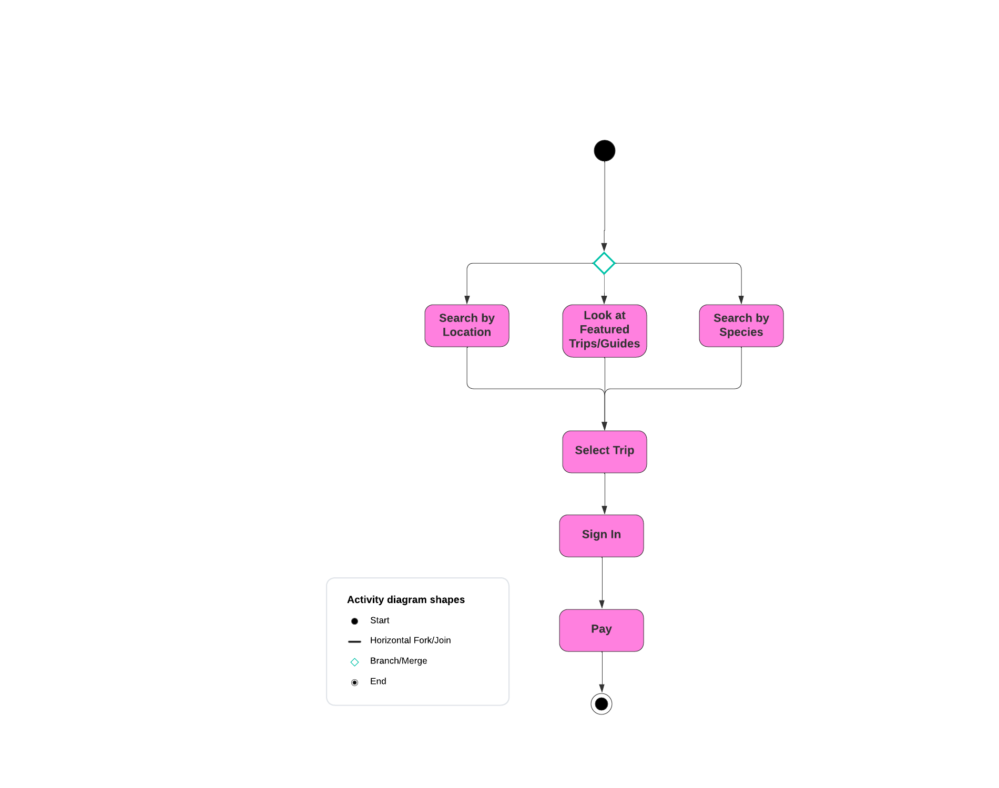
Process Model As-Is

Slide 11
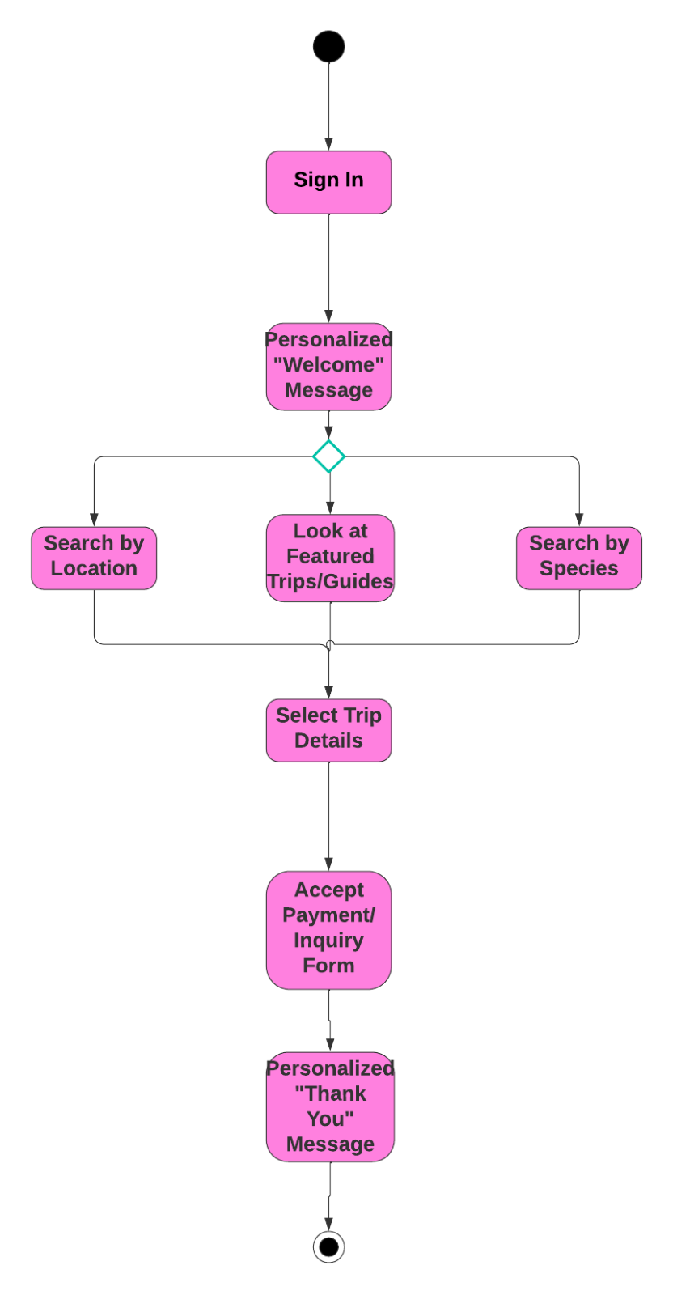
Process Model To-Be

Slide 12



Conclusion
Goal:
Our goal is to help Guide Book design the premium exclusive website that helps their business grow and stand out from competitors.
How:
Align with the needs and priorities
Innovative solutions
Room for scalability
Clear: objectives and risk
Questions?

